Slide 1
HOW TO VIEW
PERMIT INFORMATION
SAUSALITO eTRAKiT

Slide 2
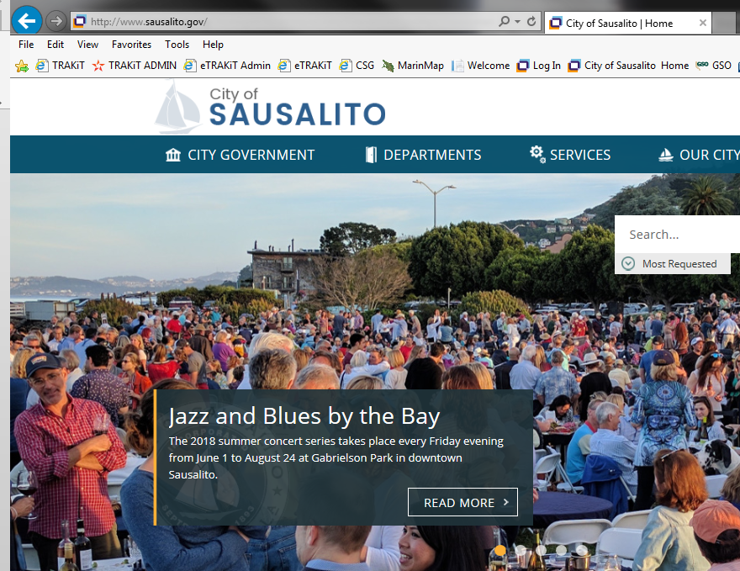
Go to the City of Sausalito’s website at www.sausalito.gov

Slide 3
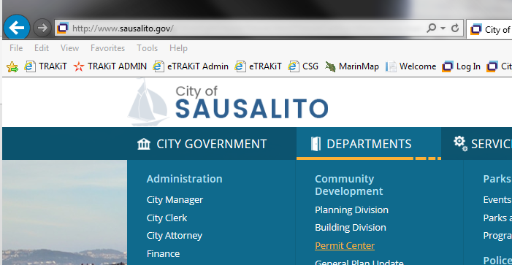
Under “Departments”, in the Community Development section, click on “Permit Center”.
PLACE MOUSE OVER TO OPEN SCROLL LIST
CLICK HERE

Slide 4
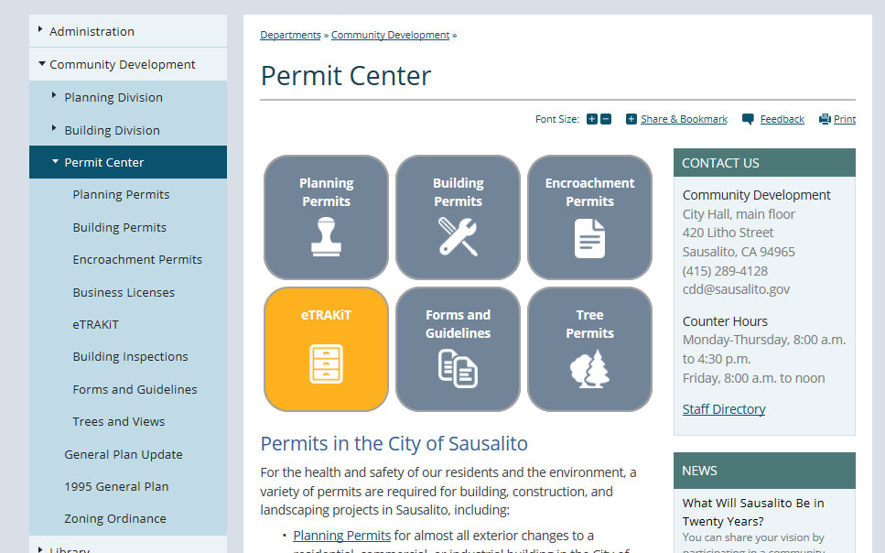
Under “Permit Center”, click on the “eTRAKiT” icon box.

Slide 5
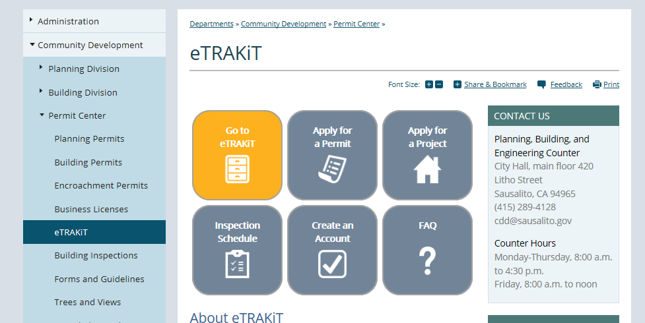
Click the “Go to eTRAKiT” icon box to redirect you to the eTRAKiT website

Slide 6
Anonymous Search Capability
Look up permit information based on address, parcel number, or permit number. You can view permit info, site info, contacts, fees, conditions, and reviews.
Look up project information based on address or project number. You can view permit info, site info, contacts, fees, conditions, and reviews.
Your search table can be exported to excel.

Slide 7
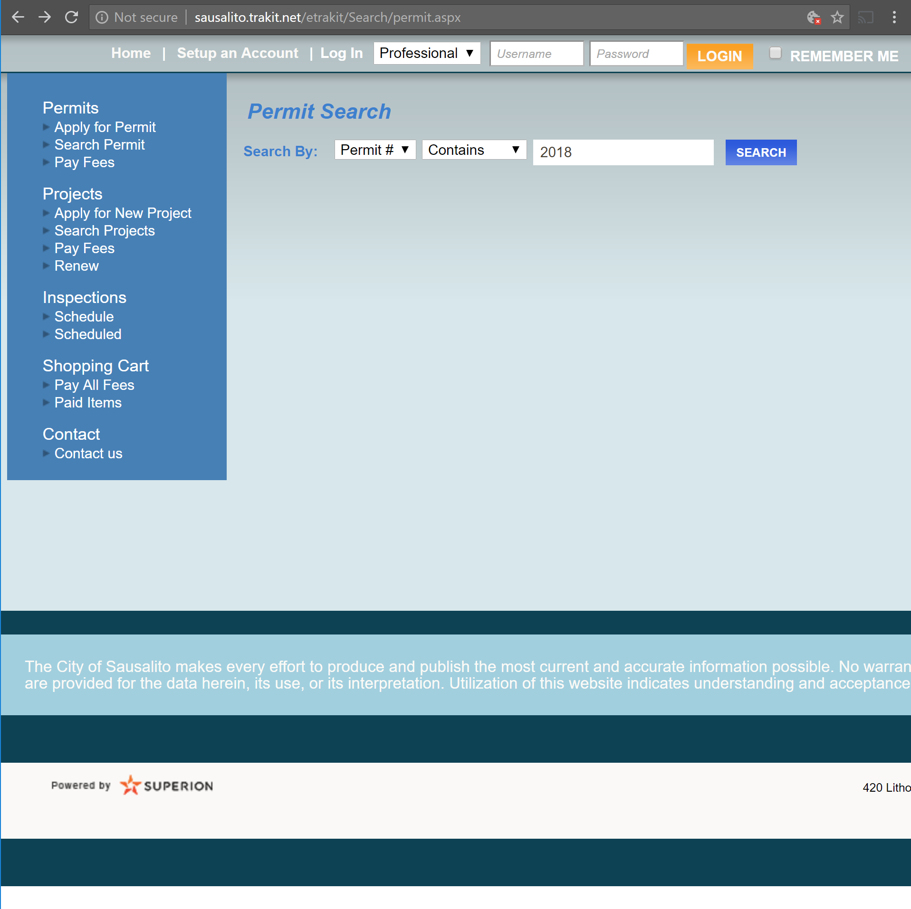
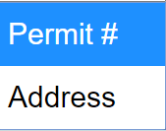
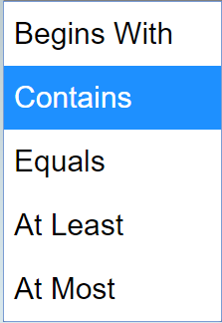
Anonymous
Permit Search
1
2
2
3
3
4
4
http://sausalito.trakit.net/etrakit/Search/permit.aspx
Select query field. Search by permit number or by address.
Select filter parameters. Set the filter to “Equals”, “Begins with”, “Contains”, “At Least”, or “At Most”.
Eenter search term.
Click on ”SEARCH”.
Browse results.
The search table can be exported to a spreadsheet.

Slide 8
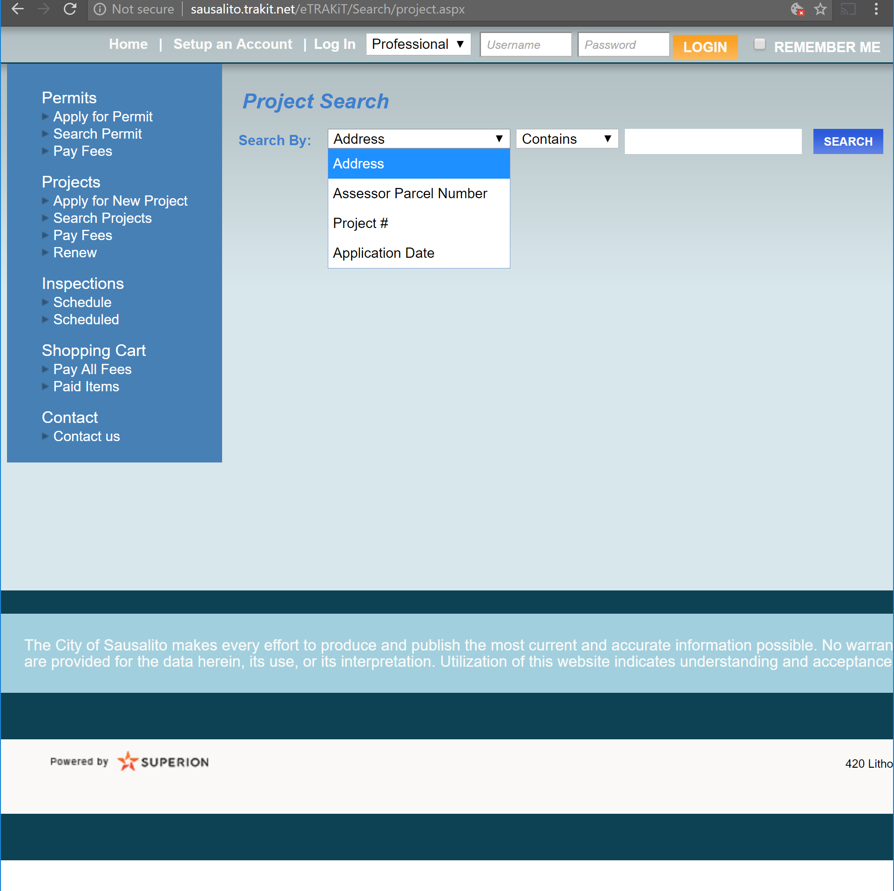
Anonymous Project Search
1
2
3
4
http://sausalito.trakit.net/eTRAKiT/Search/project.aspx
Select query field. Search by Address, Parcel number, Permit Number or Application Date.
Select filter parameters. Set the filter to “Equals”, “Begins with”, “Contains”, “At Least”, or “At Most”.
Eenter search term.
Click on ”SEARCH”.
Browse results.
The search table can be exported to a spreadsheet.

Slide 9
Registered Public Account Search Function
You must first log in on your registered public account.
Look up permit information based on permit number, address, or parcel number.
Look up project information based on address or project number.
Your search table can be exported to excel.

Slide 10

Public Account
Permit Search
1
2
2
3
3
4
4
http://sausalito.trakit.net/etrakit/Search/permit.aspx
Select query field. Search by permit number, address or parcel number.
Select filter parameters. Set the filter to “Equals”, “Begins with”, “Contains”, “At Least”, or “At Most”.
Eenter search term.
Click on ”SEARCH”.
Browse results.
The search table can be exported to a spreadsheet.

Slide 11
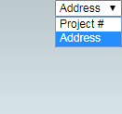
Public Account Project Search
1
2
3
4
http://sausalito.trakit.net/eTRAKiT/Search/project.aspx
Select query field. Search by Address, Parcel number, Permit Number or Application Date.
Select filter parameters. Set the filter to “Equals”, “Begins with”, “Contains”, “At Least”, or “At Most”.
Eenter search term.
Click on ”SEARCH”.
Browse results.
The search table can be exported to a spreadsheet.

Slide 12
Registered Professional Account Search Function
You must first log in on your registered professional account.
Look up permit information based on permit number, address permit type, property owner, parcel number, or description
Look up project information based on address or project number.
Your search table can be exported to excel.

Slide 13

Professional Account
Permit Search
1
2
2
3
3
4
4
http://sausalito.trakit.net/etrakit/Search/permit.aspx
Select query field. Search by permit number, address permit type, property owner, parcel number, or description.
Select filter parameters. Set the filter to “Equals”, “Begins with”, “Contains”, “At Least”, or “At Most”.
Eenter search term.
Click on ”SEARCH”.
Browse results.
The search table can be exported to a spreadsheet.

Slide 14
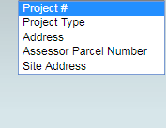
Professional Account Project Search
1
2
3
4
http://sausalito.trakit.net/eTRAKiT/Search/project.aspx
Select query field. Search by Address, Parcel number, Permit Number or Application Date.
Select filter parameters. Set the filter to “Equals”, “Begins with”, “Contains”, “At Least”, or “At Most”.
Eenter search term.
Click on ”SEARCH”.
Browse results.
The search table can be exported to a spreadsheet.

